Slide 1

Challenge 3 Gubkin Team

Slide 2
1. Well logs

Slide 3
PDF → SVG polylines
Script for Inkspace

Slide 4
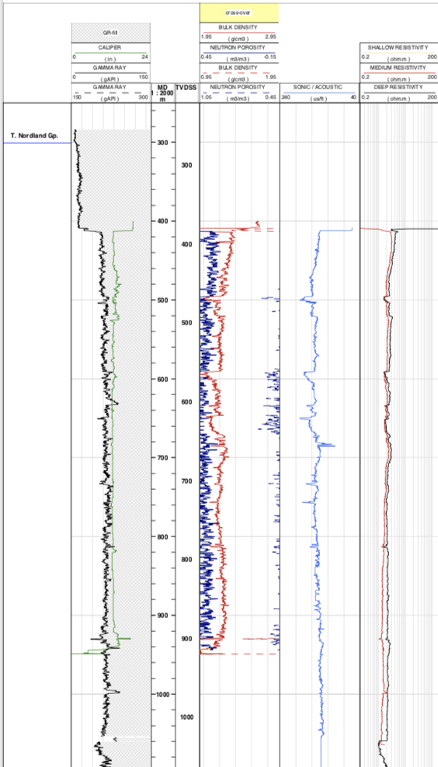
Data completeness
Bottom bound
Upper bound

Slide 5
Measurements
 | 6201_11-1 | 6201_11-2 | 6204_10-2_A | 6204_10-2_R | 6204_11-1 | 6406_3-2 | 6506_12-5 | X
NEUTRON POROSITY | X | X | X | X | X | X |  | X
BULK DENSITY | X | X | X | X | X | X |  | X
SHALLOW RESISTIVITY | X |  |  |  | X | X | X | X
CALIPER | X |  | X | X | X | X | X | X
DEEP RESISTIVITY | X | X |  | X | X | X | X | X
MEDIUM RESISTIVITY | X | X | X | X | X | X | X | X
GAMMA RAY | X |  | X | X | X | X | X | X
SONIC | X |  | X | X | X | X | X | X

Slide 6
Remove anomaly wells

Slide 7
Removed wells and measurements
 | 6201_11-1 | 6201_11-2 | 6204_10-2_A | 6204_10-2_R | 6204_11-1 | 6406_3-2 | 6506_12-5 | X
NEUTRON POROSITY | X | X | X | X | X | X |  | X
BULK DENSITY | X | X | X | X | X | X |  | X
SHALLOW RESISTIVITY | X |  |  |  | X | X | X | X
CALIPER | X |  | X | X | X | X | X | X
DEEP RESISTIVITY | X | X |  | X | X | X | X | X
MEDIUM RESISTIVITY | X | X | X | X | X | X | X | X
GAMMA RAY | X |  | X | X | X | X | X | X
SONIC | X |  | X | X | X | X | X | X

Slide 8
SVG cloud of points → TXT file with a vector of linear interpolated function of constant depth step
MATLAB script

Slide 9
Data format
Matrix
cols
rows
Well #1
Well #2
Well #3
Well #4
Well #5
A row is a 7 measurements vector on the same depth of a well
[42.724783 72.046957 36.064348 58.902609 36.655652 8.505652 89.302087]

Slide 10
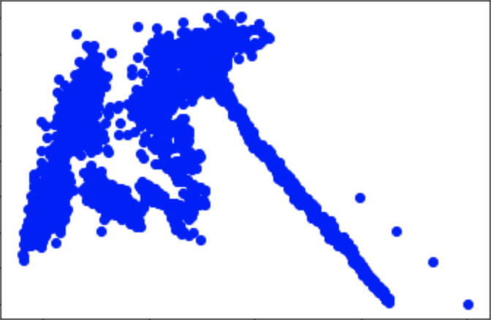
PCA analysis shows that 2 measurements are enough to describe 90% of the data

Slide 11
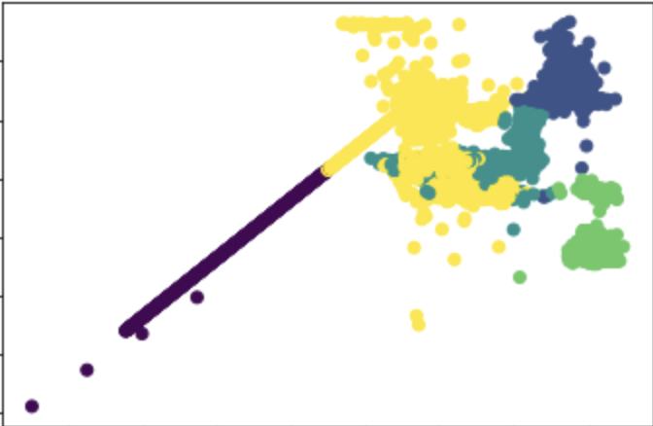
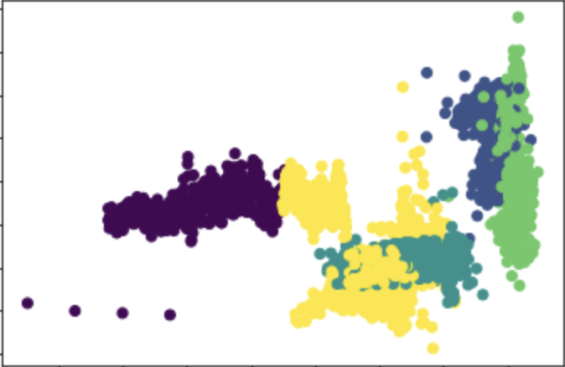
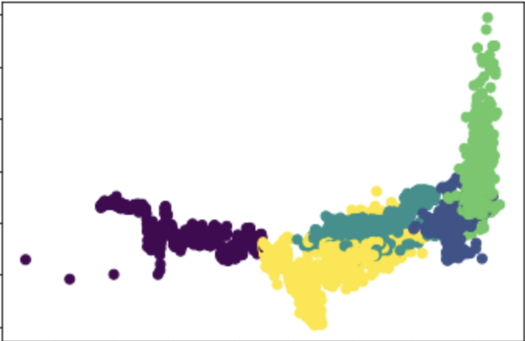
K-means clusterization
The best number of clusters is 5
based on class balance

Slide 12
K-means clusterization
Clustering algorithm
groups observation by wells!

Slide 13
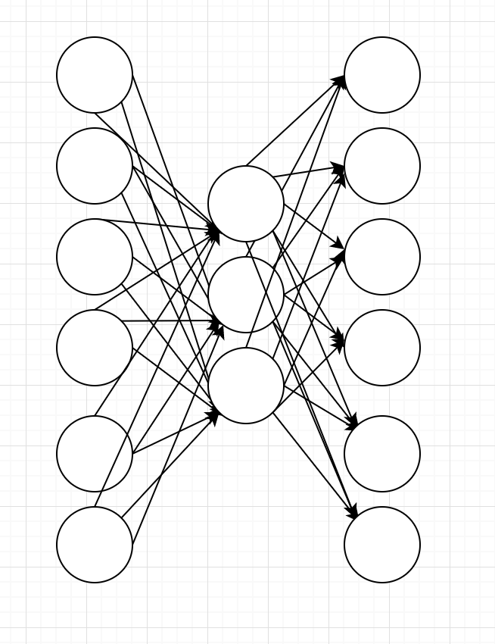
Use autoencoder feature space for clustering
Feature
space
Depth
observation
Depth
observation

Slide 14
2. CNN for lithology photos

Slide 15
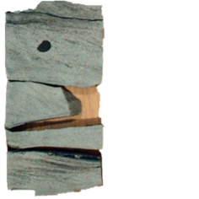
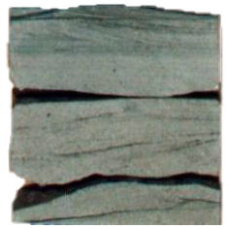
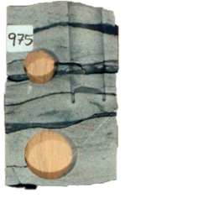
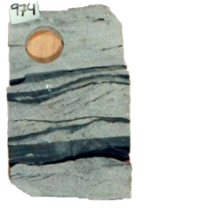
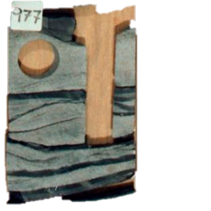
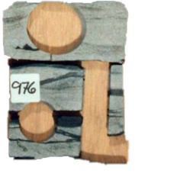
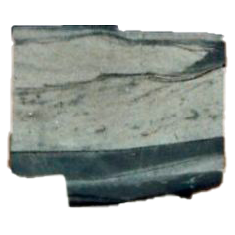
Extract rock images from photos with pyImSegm tool

Slide 16
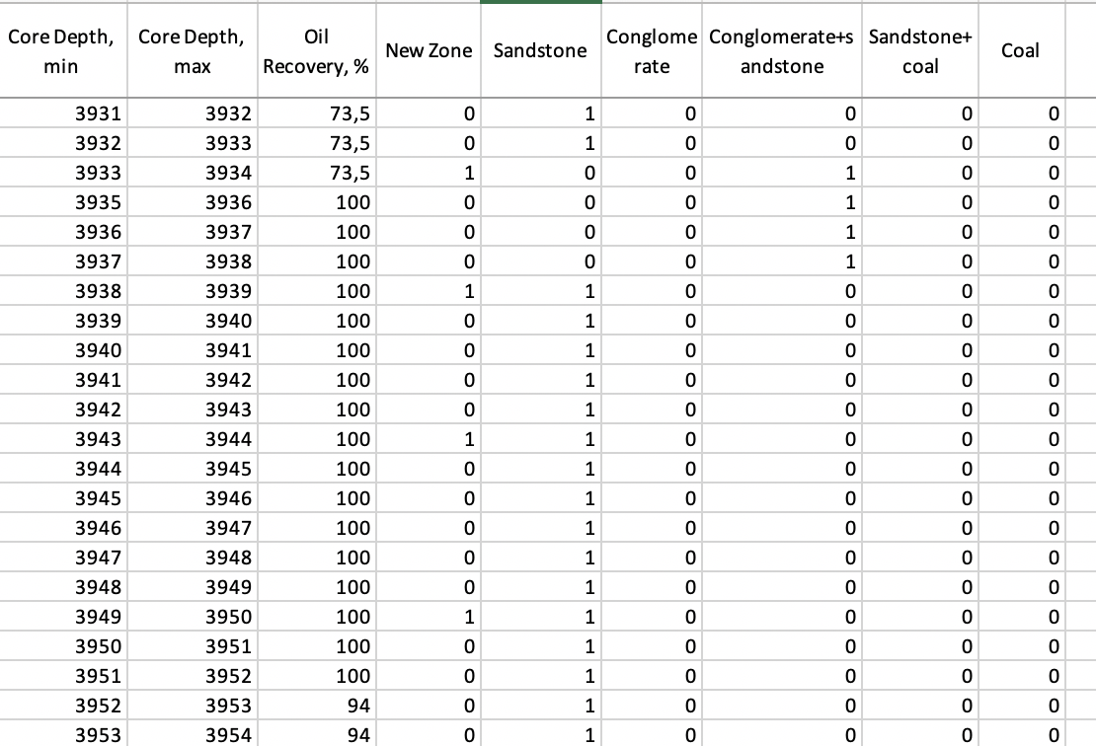
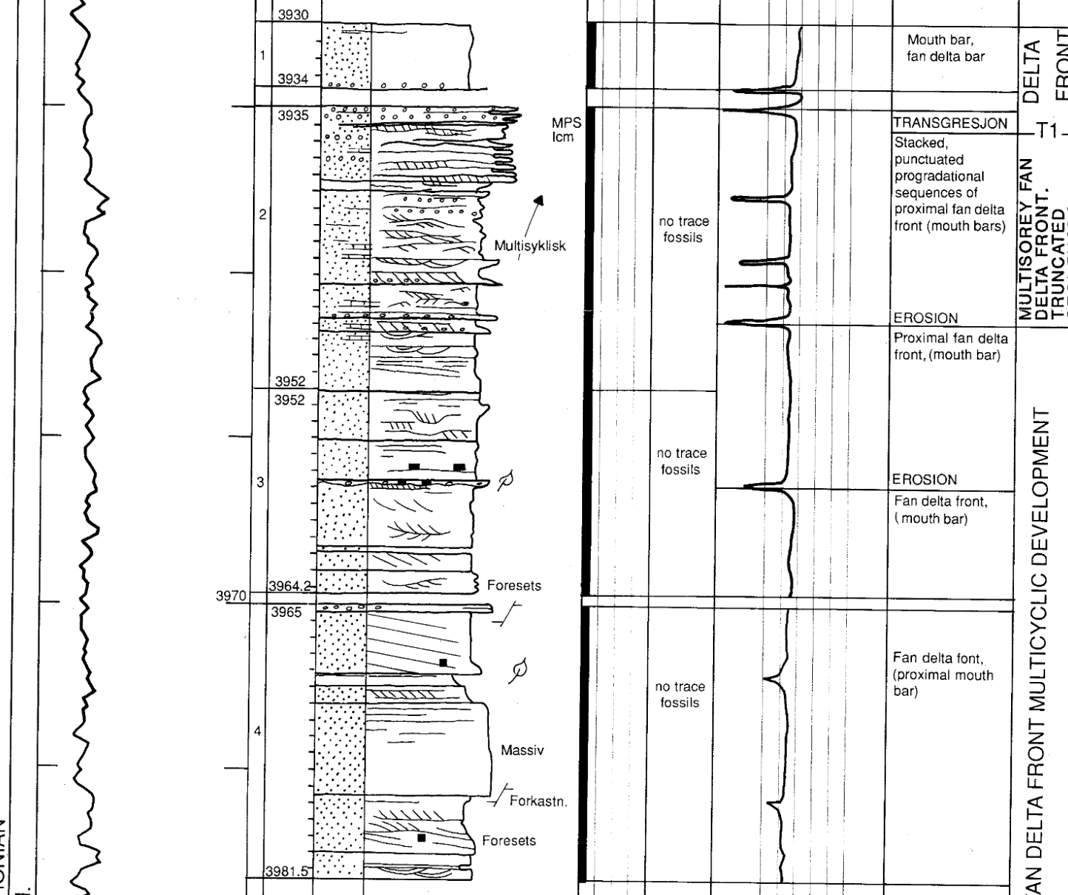
Digitize the lithology logs to CSV

Slide 17
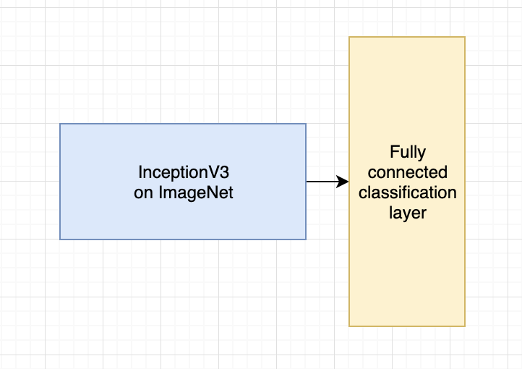
CNN classifier
First transfer learning and fine tuning
on texture dataset
KTH-TIPS and KTH-TIPS2
using transferred weights from ImageNet
The final layer should have N lithology binary outputs,
we have chosen 6
1 | 2 | 3 | 4 | 5 | 6 | 7
0 or 1 | 0 or 1 | 0 or 1 | 0 or 1 | 0 or 1 | 0 or 1 | 0 or 1
Second transfer learning and fine tuning
on rock photo dataset

Slide 18
CNN classifier. Demo on 6506_12-5
3148 | 3149 | 0 | 0 | 0 | 0 | 0 | 1
3149 | 3150 | 0 | 0 | 0 | 0 | 0 | 1
3150 | 3151 | 0 | 0 | 0 | 0 | 0 | 1
3151 | 3152 | 0 | 0 | 0 | 0 | 0 | 1
3152 | 3153 | 0 | 0 | 0 | 0 | 0 | 1
3153 | 3154 | 0 | 0 | 0 | 0 | 0 | 1
3154 | 3155 | 0 | 0 | 0 | 0 | 0 | 1
3155 | 3156 | 0 | 0 | 0 | 0 | 1 | 0
3156 | 3157 | 0 | 0 | 0 | 0 | 1 | 0
3157 | 3158 | 0 | 0 | 0 | 0 | 1 | 0
3158 | 3159 | 0 | 0 | 0 | 0 | 1 | 0
3159 | 3160 | 0 | 0 | 0 | 0 | 1 | 0
3160 | 3161 | 0 | 0 | 0 | 0 | 1 | 0
3161 | 3162 | 0 | 0 | 0 | 0 | 1 | 0
3162 | 3163 | 0 | 0 | 0 | 0 | 1 | 0
3163 | 3164 | 0 | 0 | 0 | 0 | 1 | 0
3164 | 3165 | 0 | 0 | 0 | 0 | 1 | 0
3165 | 3166 | 0 | 0 | 0 | 0 | 1 | 0
3166 | 3167 | 0 | 0 | 0 | 0 | 1 | 0
3167 | 3168 | 0 | 0 | 0 | 0 | 1 | 0
3168 | 3169 | 0 | 0 | 0 | 0 | 1 | 0
3169 | 3170 | 0 | 0 | 0 | 0 | 1 | 0
3170 | 3171 | 0 | 0 | 0 | 0 | 1 | 0
3171 | 3172 | 0 | 0 | 0 | 0 | 1 | 0
3172 | 3173 | 0 | 0 | 0 | 0 | 1 | 0
3173 | 3174 | 0 | 0 | 0 | 0 | 1 | 0
3174 | 3175 | 0 | 0 | 0 | 0 | 1 | 0
Hand-check accuracy 54%

Slide 19
3. Future ideas
Investigate the measurements more deeply.
With autoencoder feature space the possibility of good clusterization is high.
The autoencoder can also be used to remove outliers (bad measurements).
We think that the trained CNN should be used to generate the missing ground truth data (lithology logs) for all wells.
Train a deep classifier (possibly with recurrent architecture due to the depth nature) on real and generated lithology logs, do not try to connect cluster features with CNN features.

Slide 20
Thank you for your attention!

